Slide 1
Introduction to Redux

Slide 2
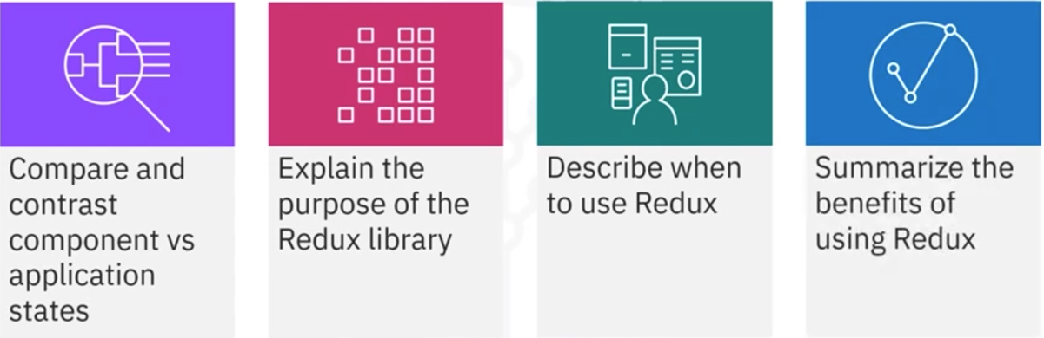
What you will Learn

Slide 3


Component versus application states
Stores data for the
entire application
Application state data
Accessible from
anywhere in the
application

Slide 4

Example
View
Edit
Checkout

Slide 5

Purpose
Redux maintains its state at the application level
Alternative to managing states in components

Slide 6





Large applications

Slide 7

Common data
Same data multiple
location
Hard to track
Update state
anywhere
Reduces the need
For new object

Slide 8
Framework independent
Large React
application
React
Vue
JavaScript
Angular

Slide 9

Redux store

Slide 10
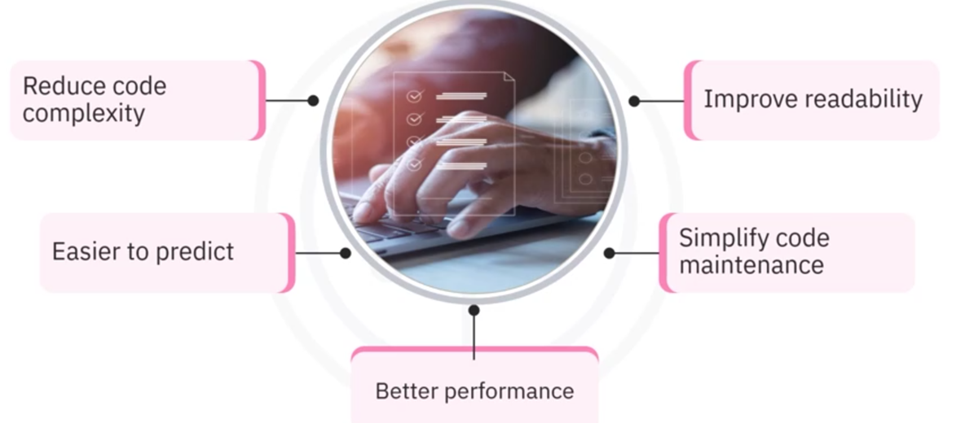
Benefits

Slide 11
Recap
In this video, you learned that:
• An application state holds data about the entire application, and
you can access this data from any particular component
• You can use the Redux library to manage your application's state
• Useful when you need to pass data from one part of your
component tree to another
• Benefits of Redux include reducing code complexity, improving
code readability, better performance, and easier code
maintenance

